Slide 1

Model Improvement and Performance
UNIT-1 INTRODUCTION
MODULE -01

Slide 2
UNIT-1 INTRODUCTION
Curse of Dimensionality,
Bias and Variance Trade off,
Overfitting and underfitting,
Regression - MAE, MSE, RMSE, R Squared, Adjusted R Squared, p-Value,
Classification - Precision, Recall, F1, Other topics, K-Fold Cross validation, RoC curve,
Hyper-Parameter Tuning Introduction – Grid search, random search,
Introduction to Deep Learning.

Slide 3
UNIT-1 Curse of Dimensionality,
Curse of Dimensionality refers to a set of problems that arise when working with high-dimensional data.
The difficulties related to training machine learning models due to high dimensional data is referred to as ‘Curse of Dimensionality’.
The popular aspects of the curse of dimensionality; ‘data sparsity’ and ‘distance concentration’

Slide 4
UNIT-1 Curse of Dimensionality,
Data Sparsity
Data sparsity refers to a situation where the available data is insufficient or incomplete for a particular analysis or task.
In the context of data analysis and machine learning, data sparsity occurs when many of the potential variables or combinations of variables have little or no observed data points.
This lack of data can lead to challenges when trying to build accurate models, make predictions, or draw meaningful insights.

Slide 5
UNIT-1 Curse of Dimensionality,
Data sparsity can arise for various reasons, including:
Rare Events: In certain situations, events or occurrences might be rare, leading to sparse data. For example, in fraud detection, actual fraudulent transactions are much less common than legitimate ones.
High-Dimensional Data: When dealing with data that has a high number of features or dimensions, it's more likely that some combinations of features will have few or no data points, leading to sparsity.
Cold-Start Problem: In recommendation systems, when a new item or user is introduced to the system, there might be very little data available for making accurate recommendations.
Long-Tail Distribution: In scenarios where the distribution of data follows a long-tail distribution, a few instances dominate, while the rest have minimal representation, leading to sparsity in the tail.
Sparse Sampling: In experimental or observational studies, certain conditions or groups might be underrepresented due to limitations in data collection methods.

Slide 6
UNIT-1 Curse of Dimensionality,
Techniques to address data sparsity
Feature Engineering: Creating new features or combining existing ones can help alleviate sparsity by providing additional information.
Data Imputation: Filling in missing or sparse data points using statistical methods or imputation algorithms can help create a more complete dataset.
Dimensionality Reduction: Reducing the number of dimensions or features can help mitigate sparsity by reducing the number of combinations with limited data.
Regularization: In machine learning models, regularization techniques like L1 regularization (Lasso) can help in feature selection and mitigate the impact of sparse features.
Ensemble Methods: Combining predictions from multiple models or algorithms can help reduce the impact of sparsity on the overall predictive power.
Matrix Factorization: In recommendation systems, matrix factorization techniques can help fill in missing values by learning latent factors from the available data.
Synthetic Data Generation: Generating synthetic data points can help balance out the representation of different categories, especially in cases where certain categories are severely underrepresented.

Slide 7
UNIT-1 Curse of Dimensionality,
Distance concentration
In the context of machine learning, the term "distance concentration" could potentially refer to a phenomenon where distances between data points in a high-dimensional space become more concentrated or consistent.
This could imply that the data points are exhibiting certain patterns or clusters that are characterized by specific distances between them.
Such a phenomenon could have implications for various aspects of machine learning, such as clustering, anomaly detection, and feature selection.
For example, if data points in a high-dimensional space tend to cluster around specific distances from each other, it might suggest that certain groups or classes of data have inherent structures that are closely related in terms of their feature values.
This could be useful for tasks like clustering, where identifying groups of similar data points is important.

Slide 8
UNIT-1 Curse of Dimensionality,
Domains of curse of dimensionality
Anomaly Detection
Anomaly detection is used for finding unforeseen items or events in the dataset. In high-dimensional data anomalies often show a remarkable number of attributes which are irrelevant in nature; certain objects occur more frequently in neighbour lists than others.
Combinatorics
Whenever, there is an increase in the number of possible input combinations it fuels the complexity to increase rapidly, and the curse of dimensionality occurs.
Machine Learning
In Machine Learning, a marginal increase in dimensionality also requires a large increase in the volume in the data in order to maintain the same level of performance. The curse of dimensionality is the by-product of a phenomenon which appears with high-dimensional data.

Slide 9
UNIT-1 Bias and Variance Trade off,
Bias
Bias is the difference between Actual and Predicted value of a model
Bias = Actual_Value - Predicted_Value
high bias leads to large error and low bias leads to low error.
low bias helpful to avoid underfiting problem while high bias represents predicted data in a straight line that represnts not fitting data accurately.
Characteristics of a high-bias model include:
Failure to capture proper data trends
Potential towards underfitting
More generalized/overly simplified
High error rate

Slide 10
UNIT-1 Bias and Variance Trade off,
Variance
Variance represents spread of a given data in a preditive model.
High Variance model is very complex to fit training data and doesn’t work accurately over unseen data.
High Variance generates Overfitting Problem in which model works properly over training data but gives high error rate on Test data.
A high-variance model typically has the following qualities:
Noise in the data set
Potential towards overfitting
Complex models
Trying to put all data points as close as possible

Slide 11
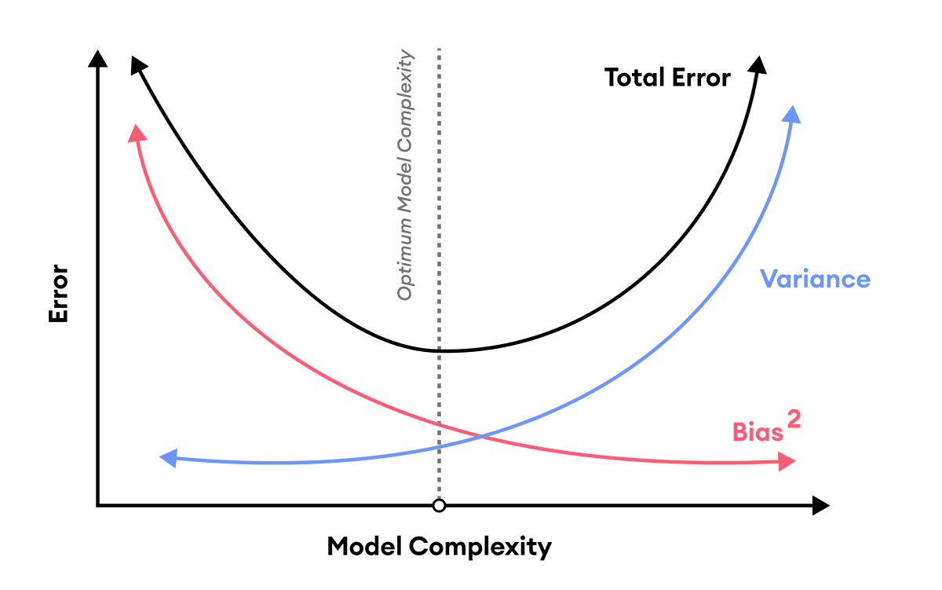
UNIT-1 Bias and Variance Trade off,
Bias Trade off/ Trade off
Simple Algorithm may leads to high bias and low variance and thus error-prone.
Complex algorithm may leads to low bias and high variance.
Bias-Trade off lies betweeen Bias and Variance.
Bias-trade off finds the optimize value of total error.
Total Error = Bias²+ Variance + Irreducible Error

Slide 12
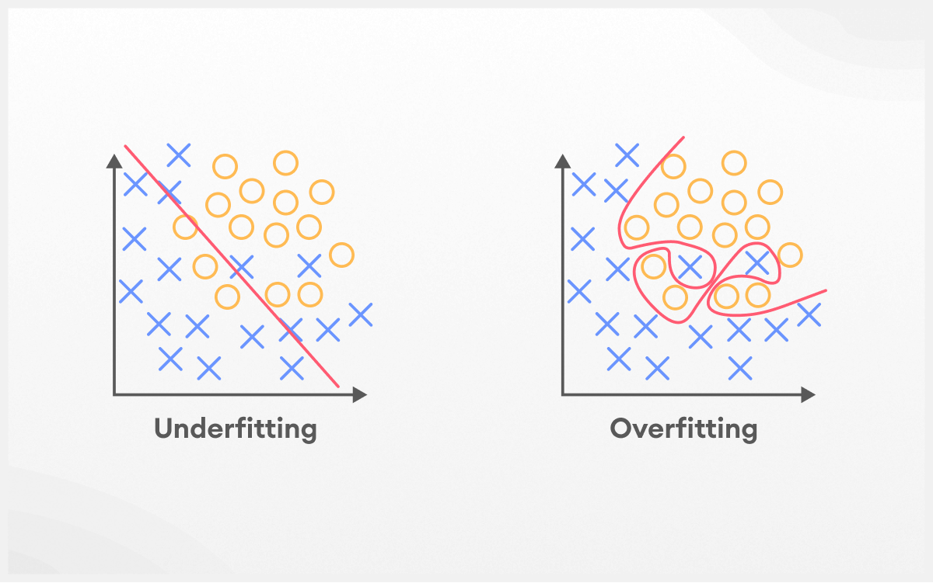
UNIT-1 Overfitting and
underfitting

Slide 13
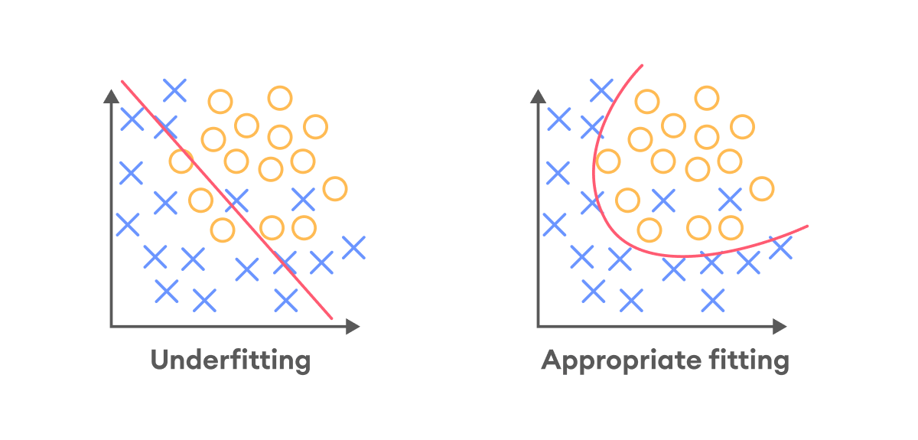
UNIT-1 Overfitting and
underfitting
Underfitting

Slide 14
UNIT-1 Overfitting and
underfitting
Underfitting
Underfitting occurs when a model is not able to make accurate predictions based on training data and hence, doesn’t have the capacity to generalize well on new data.
Another case of underfitting is when a model is not able to learn enough from training data (Figure 2), making it difficult to capture the dominating trend (the model is unable to create a mapping between the input and the target variable).
Machine learning models with underfitting tend to have poor performance both in training and testing sets.
Underfitting models usually have high bias and low variance.

Slide 15
UNIT-1 Overfitting and
underfitting
Way of detecting underfitting
Training and test loss: If the model is underfitting, the loss for both training and validation will be considerably high.
Over simplistic prediction graph: If a graph with the data points and the fitted curve is plotted, and the classifier curve is oversimplistic, then, most probably, your model is underfitting.

Slide 16
UNIT-1 Overfitting and
underfitting
Way of avoiding underfitting
Train a more complex model – Lack of model complexity in terms of data characteristics is the main reason behind underfitting models.
Training a more complex model will help us solve the problem of underfitting.
More time for training - Early training termination may cause underfitting. As a machine learning engineer, you can increase the number of epochs or increase the duration of training to get better results.
Eliminate noise from data – Another cause of underfitting is the existence of outliers and incorrect values in the dataset.
Data cleaning techniques can help deal with this problem.
Adjust regularization parameters - the regularization coefficient can cause both overfitting and underfitting models.

Slide 17
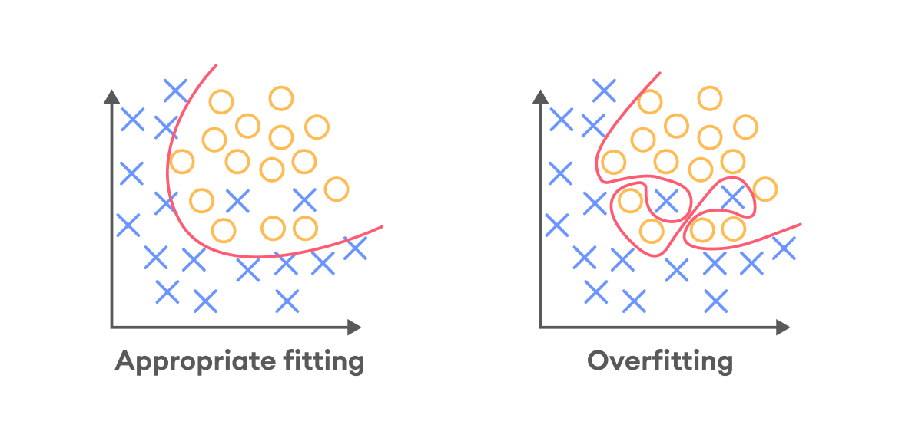
UNIT-1 Overfitting and
underfitting
Overfitting

Slide 18
UNIT-1 Overfitting and
underfitting
Overfitting
A model is considered overfitting when it does extremely well on training data but fails to perform on the same level on the validation data.
An overfitting model fails to generalize well, as it learns the noise and patterns of the training data to the point where it negatively impacts the performance of the model on new data.
If the model is overfitting, even a slight change in the output data will cause the model to change significantly.
Models that are overfitting usually have low bias and high variance

Slide 19
UNIT-1 Overfitting and
underfitting
Way of detecting overfitting
Use a resampling technique to estimate model accuracy. The most popular resampling technique is k-fold cross-validation. It allows you to train and test your model k-times on different subsets of training data and build up an estimate of the performance of a machine learning model on unseen data. The drawback here is that it is time-consuming and cannot be applied to complex models, such as deep neural networks.
Hold back a validation set. Once a model is trained on the training set, you can evaluate it on the validation dataset, then compare the accuracy of the model in the training dataset and the validation dataset. A significant variance in these two results allows assuming that you have an overfitted model.

Slide 20
UNIT-1 Overfitting and
underfitting
Way of preventing overfitting
Adding more data – Most of the time, adding more data can help machine learning models detect the “true” pattern of the model, generalize better, and prevent overfitting. However, this is not always the case, as adding more data that is inaccurate or has many missing values can lead to even worse results.
Early stopping – In iterative algorithms, it is possible to measure how the model iteration performance. Up until a certain number of iterations, new iterations improve the model. After that point, however, the model’s ability to generalize can deteriorate as it begins to overfit the training data. Early stopping refers to stopping the training process before the learner passes that point.

Slide 21
UNIT-1 Overfitting and
underfitting
Way of preventing overfitting
Data augmentation – In machine learning, data augmentation techniques increase the amount of data by slightly changing previously existing data and adding new data points or by producing synthetic data from a previously existing dataset.
Remove features – You can remove irrelevant aspects from data to improve the model. Many characteristics in a dataset may not contribute much to prediction. Removing non-essential characteristics can enhance accuracy and decrease overfitting.

Slide 22
UNIT-1 Overfitting and
underfitting
Way of preventing overfitting
Regularization – Regularization refers to a variety of techniques to push your model to be simpler. The approach you choose will be determined by the model you are training. For example, you can add a penalty parameter for a regression (L1 and L2 regularization), prune a decision tree or use dropout on a neural network.
Ensembling – Ensembling methods merge predictions from numerous different models. These methods not only deal with overfitting but also assist in solving complex machine learning problems (like combining pictures taken from different angles into the overall view of the surroundings). The most popular ensembling methods are boosting and bagging.

Slide 23
UNIT-1 Overfitting and
underfitting
Way of preventing overfitting
Ensembling –
Boosting – In boosting method, you train a large number of weak learners (constrained models) in sequence, and each sequence learns from the mistakes of the previous sequence. Then you combine all weak learners into a single strong learner.
Bagging is another technique to reduce overfitting. It trains a large number of strong learners (unconstrained models) and then combines them all in order to optimize their predictions.

Slide 24
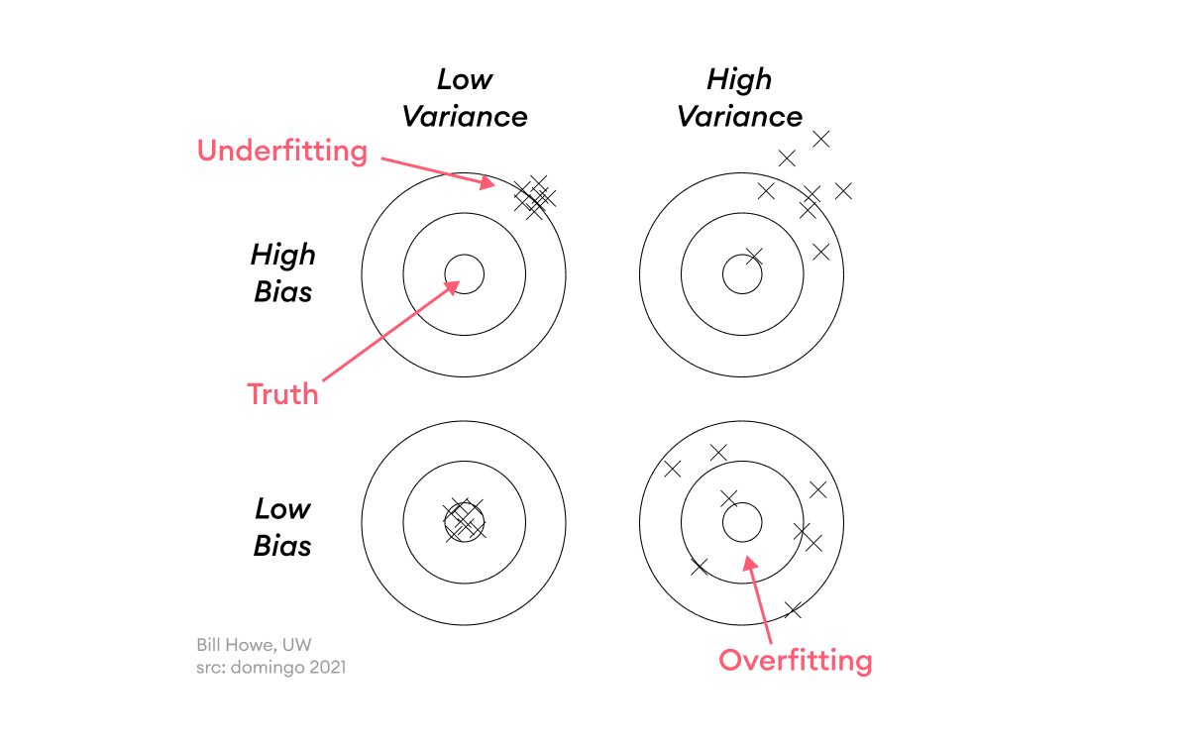
UNIT-1 Overfitting and
underfitting
Overfitting and underfitting using a dart analogy

Slide 25
UNIT-1 Regression
Regression analysis is a set of statistical methods used for the estimation of relationships between a dependent variable and one or more independent variables.
Regression analysis includes several variations, such as linear, multiple linear, and nonlinear.
The most common models are simple linear and multiple linear.
Nonlinear regression analysis is commonly used for more complicated data sets in which the dependent and independent variables show a nonlinear relationship.

Slide 26
UNIT-1 Regression
Regression Analysis
Simple Linear Regression: A model that assesses the relationship between a dependent variable and an independent variable
Y = mx + c + e
Where:
Y – Dependent variable
x – Independent (explanatory) variable
c – Intercept
m – Slope
e – Residual (error)

Slide 27
UNIT-1 Regression
Multiple linear regression analysis is essentially similar to the simple linear model, with the exception that multiple independent variables are used in the model.
The mathematical representation of multiple linear regression is:
Y = a + bX1 + cX2 + dX3 + ϵ
Where:
Y – Dependent variable
X1, X2, X3 – Independent (explanatory) variables
a – Intercept
b, c, d – Slopes
ϵ – Residual (error)

Slide 28
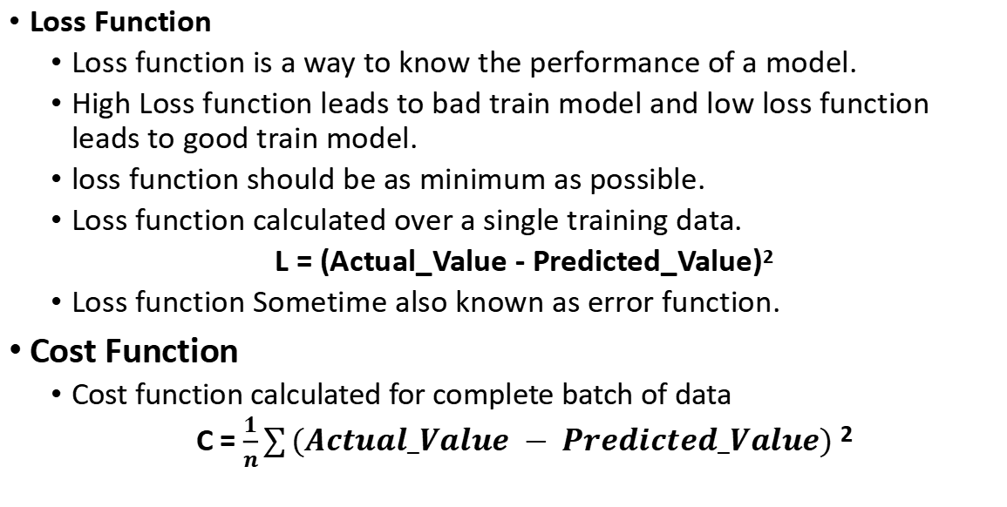
UNIT-1 Regression
Loss Function
Loss function is a way to know the performance of a model.
High Loss function leads to bad train model and low loss function leads to good train model.
loss function should be as minimum as possible.
Loss function calculated over a single training data.
L = (Actual_Value - Predicted_Value)²
Loss function Sometime also known as error function.
Cost Function
Cost function calculated for complete batch of data
C = $\frac{1}{n}\sum{(Actual_Value − Predicted_Value)}$ ²

Slide 29
UNIT-1 Regression
Example for Loss and Cost Function
Roll No. | CGPA | IQ | Actual_Value | Predicted_Value | Loss Function | Cost Function
 |  |  | Package | Predicted
1 | 5.2 | 100 | 6.3 | 6.4 | 0.01 | 3.475
2 | 4.3 | 91 | 4.5 | 5.3 | 0.64
3 | 8.2 | 83 | 6.5 | 5.2 | 1.69
4 | 8.9 | 102 | 5.5 | 8.9 | 11.56
NOTE: Loss function calculated for Individual Data while Cost Function calculate for Entire Dataset

Slide 30
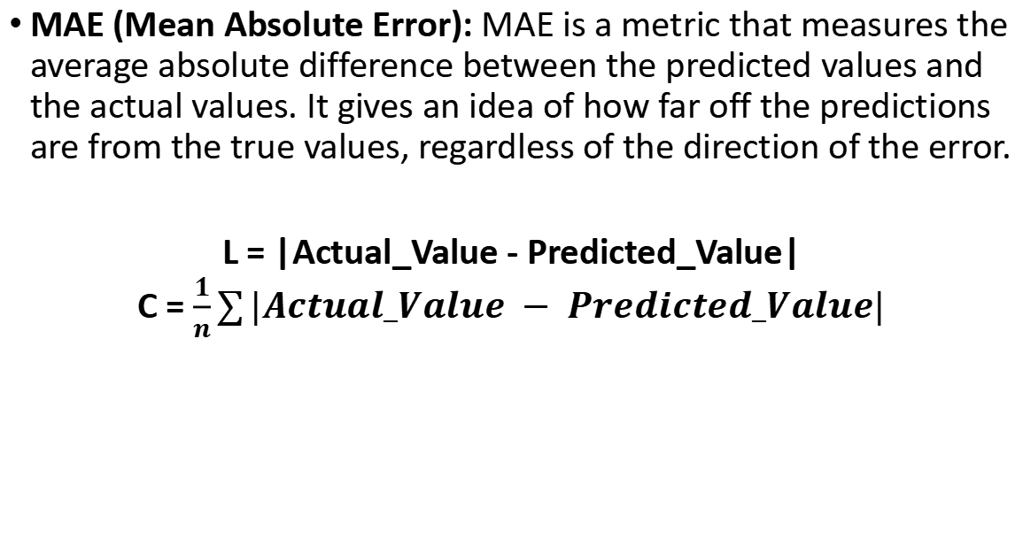
UNIT-1 Regression
MAE (Mean Absolute Error): MAE is a metric that measures the average absolute difference between the predicted values and the actual values. It gives an idea of how far off the predictions are from the true values, regardless of the direction of the error.
L = |Actual_Value - Predicted_Value|
C = $\frac{1}{n}\sum{|Actual_Value − Predicted_Value|}$

Slide 31
UNIT-1 Regression
Advantages
Easy to Understand
Same unit as unit of Actual_Value
It is Robust to Outlier: It means outlier will not affect error, so if there is no outliers in dataset then it better to use MAE instead of MSE
Disadvantages
Grap is not differenciable due which Gradient Descent(GD) algorithm not easy to implement.
To implement GD we need to calculate Sub-Gradient.

Slide 32
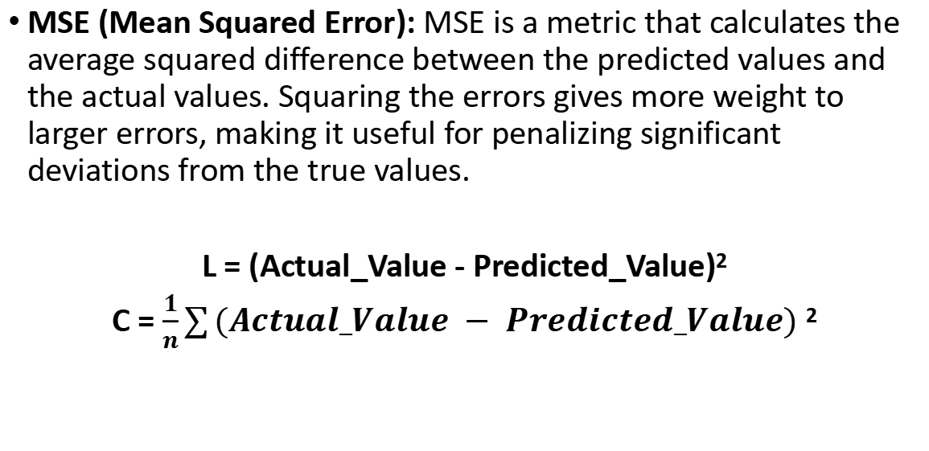
UNIT-1 Regression
MSE (Mean Squared Error): MSE is a metric that calculates the average squared difference between the predicted values and the actual values. Squaring the errors gives more weight to larger errors, making it useful for penalizing significant deviations from the true values.
L = (Actual_Value - Predicted_Value)²
C = $\frac{1}{n}\sum{(Actual_Value − Predicted_Value)}$ ²

Slide 33
UNIT-1 Regression
Advantages
Easy to interpret
Loss function is differenciable that allows to implement GD easily
One Local Mininma: It means function has one minimum value that we have to find.
Disadvantage
Unit of error is Square: That creates an confusion to understand it, so to extract accurate error we have to find square root of MSE.
It is not Robust to Outlier: If dataser conists outliers then MSE is not useful

Slide 34
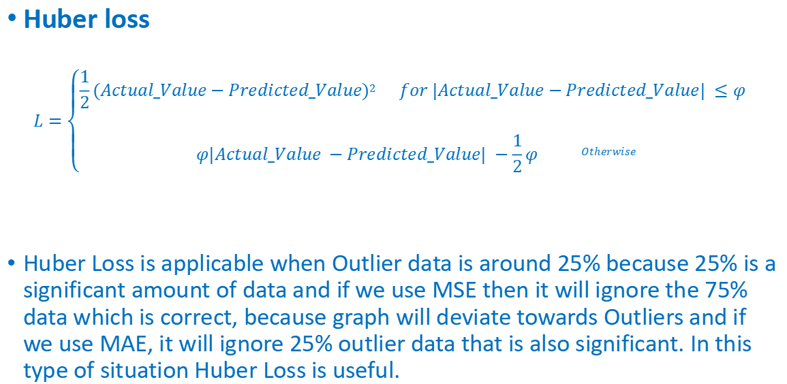
UNIT-1 Regression
Huber loss
$$L=\left\{\begin{aligned}\frac{1}{2}(Actual_Value−Predicted_Value)2 for |Actual_Value−Predicted_Value| ≤φ \\ \\ φ|Actual_Value −Predicted_Value| −\frac{1}{2}φ Otherwise\end{aligned}\right.$$
Huber Loss is applicable when Outlier data is around 25% because 25% is a significant amount of data and if we use MSE then it will ignore the 75% data which is correct, because graph will deviate towards Outliers and if we use MAE, it will ignore 25% outlier data that is also significant. In this type of situation Huber Loss is useful.

Slide 35
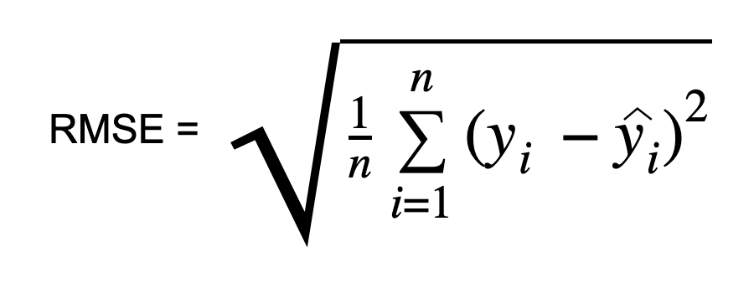
UNIT-1 Regression
RMSE
It quantifies the differences between predicted values and actual values, squaring the errors, taking the mean, and then finding the square root.
RMSE provides a clear understanding of the model’s performance, with lower values indicating better predictive accuracy.
RMSE is computed by taking the square root of MSE
RMSE value with zero indicates that the model has a perfect fit

Slide 36
UNIT-1 Regression
RMSE
The lower the RMSE, the better the model and its predictions.
A higher RMSE indicates that there is a large deviation from the residual to the ground truth.

Slide 37
UNIT-1 Regression
Pros of the RMSE Evaluation Metric:
RMSE is easy to understand.
It serves as a heuristic for training models.
It is computationally simple and easily differentiable which many optimization algorithms desire.
RMSE does not penalize the errors as much as MSE does due to the square root.
Cons of the RMSE metric:
Like MSE, RMSE is dependent on the scale of the data. It increases in magnitude if the scale of the error increases.
One major drawback of RMSE is its sensitivity to outliers and the outliers have to be removed for it to function properly.
RMSE increases with an increase in the size of the test sample. This is an issue when we calculate the results on different test samples.

Slide 38
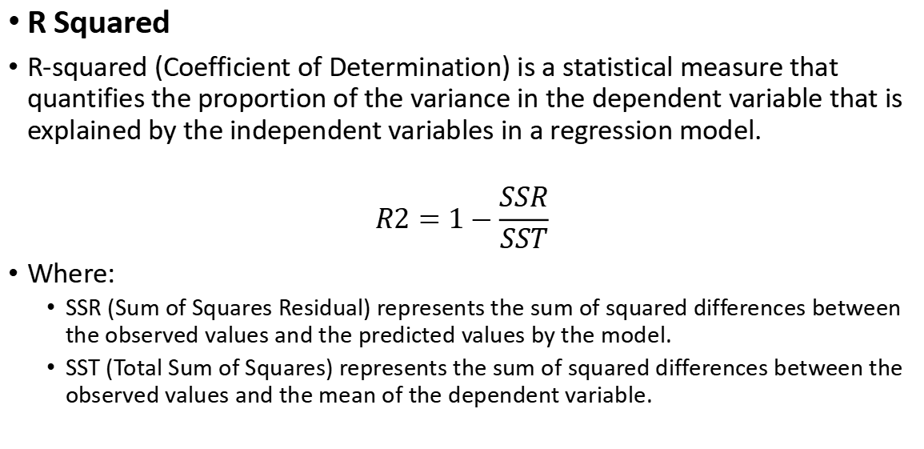
UNIT-1 Regression
R Squared
R-squared (Coefficient of Determination) is a statistical measure that quantifies the proportion of the variance in the dependent variable that is explained by the independent variables in a regression model.
$$R2=1−\frac{SSR}{SST}$$
Where:
SSR (Sum of Squares Residual) represents the sum of squared differences between the observed values and the predicted values by the model.
SST (Total Sum of Squares) represents the sum of squared differences between the observed values and the mean of the dependent variable.

Slide 39
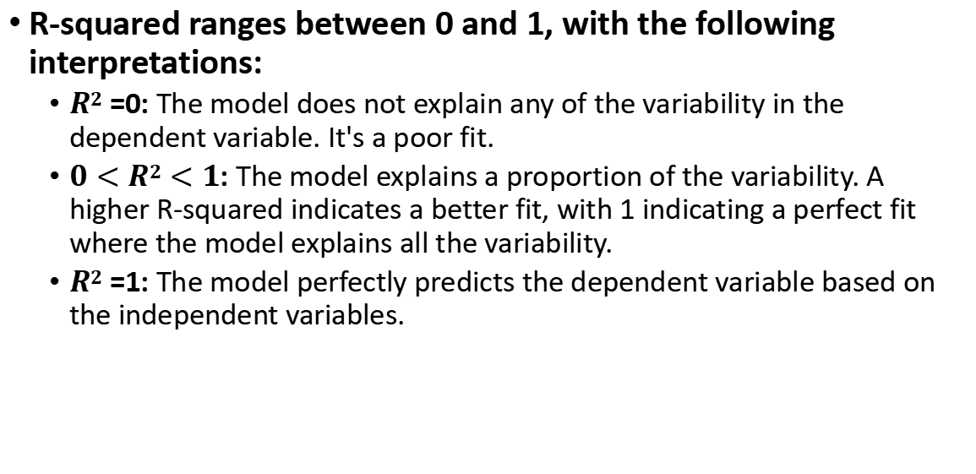
UNIT-1 Regression
R-squared ranges between 0 and 1, with the following interpretations:
$R2$ =0: The model does not explain any of the variability in the dependent variable. It's a poor fit.
$0<R2<1$: The model explains a proportion of the variability. A higher R-squared indicates a better fit, with 1 indicating a perfect fit where the model explains all the variability.
$R2$ =1: The model perfectly predicts the dependent variable based on the independent variables.

Slide 40
UNIT-1 Regression
R-squared evaluates regression model fit but has limitations:
High R-squared doesn't always mean good fit; high value may imply overfitting, lacking generalization.
Including more predictors can inflate R-squared, even if they're weak; adjusted R-squared adjusts for this.
"Good" R-squared varies by field; lower values acceptable in data-rich areas.
R-squared may miss fit quality with nonlinearity or outliers.

Slide 41
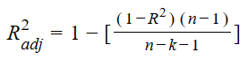
UNIT-1 Regression
Adjusted R Squared
Where −
n = the number of points in your data sample.
k = the number of independent regressors, i.e. the number of variables in your model, excluding the constant.

Slide 42
UNIT-1 Regression
Adjusted R Squared
Adjusted R-squared adjusts the statistic based on the number of independent variables in the model
Adjusted R² also indicates how well terms fit a curve or line, but adjusts for the number of terms in a model.
If you add more and more useless variables to a model, adjusted r-squared will decrease.
If you add more useful variables, adjusted r-squared will increase.
Adjusted R² will always be less than or equal to R²

Slide 43
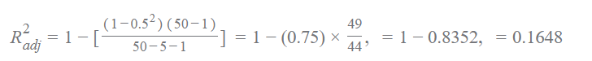
UNIT-1 Regression
Adjusted R Squared
Problem Statement −
A fund has a sample R-squared value close to 0.5 and it is doubtlessly offering higher risk adjusted returns with the sample size of 50 for 5 predictors. Find Adjusted R square value.
Sample size = 50 Number of predictor = 5 Sample R - square = 0.5.Substitute the qualities in the equation,

Slide 44
UNIT-1 Regression
p-Value,

Slide 46
UNIT-1 Regression
RMSE (Root Mean Squared Error): RMSE is the square root of the MSE and is commonly used to express the average magnitude of the prediction errors in the same units as the dependent variable. It provides a measure of the model's accuracy, and lower values indicate better performance.
R Squared (Coefficient of Determination): R-squared is a statistical measure that represents the proportion of the variance in the dependent variable that is explained by the independent variables in the regression model. It ranges from 0 to 1, where 1 indicates that the model explains all the variance, and 0 indicates that the model doesn't explain any of the variance.

Slide 47
UNIT-1 Regression
Adjusted R Squared: Adjusted R-squared is a modified version of R-squared that takes into account the number of independent variables in the model. It penalizes the addition of irrelevant variables that might artificially inflate the R-squared value.
p-Value: The p-value is a measure of the evidence against a null hypothesis in a statistical hypothesis test. In the context of regression analysis, p-values are used to determine whether the coefficients of the independent variables are statistically significant. A low p-value (typically below a significance level like 0.05) suggests that the variable has a significant impact on the dependent variable.

Slide 48
UNIT-1 Classification
A Fraud Detection Classifier
Objective: To detect fraud claim
Assumption:
The output of your fraud detection model is the probability [0.0–1.0] that a transaction is fraudulent.
If this probability is below 0.5, you classify the transaction as non-fraudulent; otherwise, you classify the transaction as fraudulent.
Methodology
Collect 10,000 manually classified transactions, with 300 fraudulent transaction and 9,700 non-fraudulent transactions.
You run your classifier on every transaction, predict the class label (fraudulent or non-fraudulent) and
summarise the results in the following confusion matrix:

Slide 49
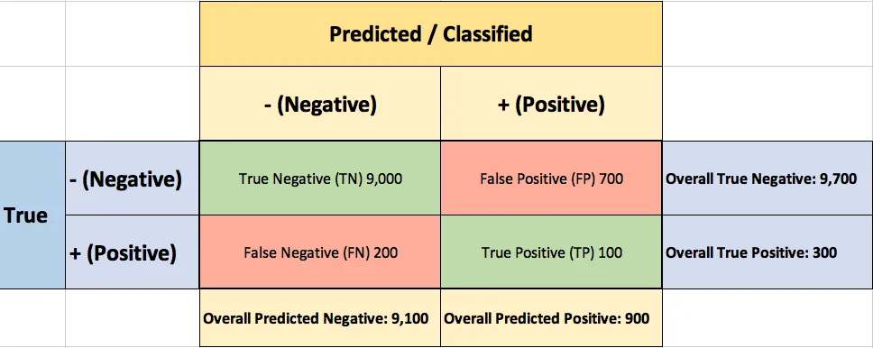
UNIT-1 Classification

Slide 50
UNIT-1 Classification
A True Positive (TP=100) is an outcome where the model correctly predicts the positive (fraudulent) class.
A True Negative (TN=9,000) is an outcome where the model correctly predicts the negative (non-fraudulent) class.
A False Positive (FP=700) is an outcome where the model incorrectly predicts the positive (fraudulent) class.
A False Negative (FN=200) is an outcome where the model incorrectly predicts the negative (non-fraudulent) class.

Slide 51
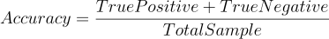
UNIT-1 Classification
Accuracy: Correctly predicted values out of total given data.
Accuracy = ?

Slide 52
UNIT-1 Classification
Area Under Curve
Area Under Curve(AUC) is one of the most widely used metrics for evaluation.
It is used for binary classification problem.
AUC of a classifier is equal to the probability that the classifier will rank a randomly chosen positive example higher than a randomly chosen negative example.
Two basic terms used in AUC:
True Positive Rate (Sensitivity)
True Negative Rate (Specificity)

Slide 53
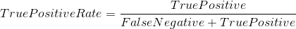
UNIT-1 Classification
Area Under Curve
Few basic terms used in AUC:
True Positive Rate (Sensitivity) : True Positive Rate is defined as TP/ (FN+TP). True Positive Rate corresponds to the proportion of positive data points that are correctly considered as positive, with respect to all positive data points.
True Negative Rate (Specificity) : True Negative Rate is defined as TN / (FP+TN). False Positive Rate corresponds to the proportion of negative data points that are correctly considered as negative, with respect to all negative data points.

Slide 54
UNIT-1 Classification
Area Under Curve
False Positive Rate : False Positive Rate is defined as FP / (FP+TN). False Positive Rate corresponds to the proportion of negative data points that are mistakenly considered as positive, with respect to all negative data points.
False Positive Rate and True Positive Rate both have values in the range [0, 1].
FPR and TPR both are computed at varying threshold values such as (0.00, 0.02, 0.04, …., 1.00) and a graph is drawn.
AUC is the area under the curve of plot False Positive Rate vs True Positive Rate at different points in [0, 1].

Slide 55
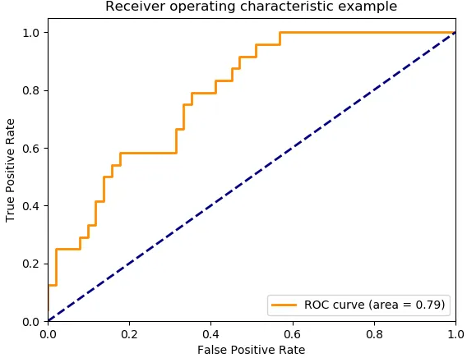
UNIT-1 Classification
Area Under Curve
As evident, AUC has a range of [0, 1]. The greater the value, the better is the performance of our model.

Slide 56
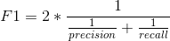
UNIT-1 Classification
F1-Score:
F1 Score is used to measure a test’s accuracy
F1 Score is the Harmonic Mean between precision and recall.
The range for F1 Score is [0, 1].
It tells you how precise your classifier is (how many instances it classifies correctly), as well as how robust it is (it does not miss a significant number of instances).
High precision but lower recall, gives you an extremely accurate, but it then misses a large number of instances that are difficult to classify.
The greater the F1 Score, the better is the performance of our model.
Mathematically, it can be expressed as :
F1 Score tries to find the balance between precision and recall.

Slide 57
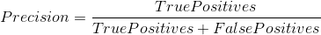
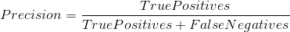
UNIT-1 Classification
Precision : It is the number of correct positive results divided by the number of positive results predicted by the classifier.
Recall : It is the number of correct positive results divided by the number of all relevant samples (all samples that should have been identified as positive).

Slide 58
UNIT-1 Classification
Cross validation is a technique used in machine learning to evaluate the performance of a model on unseen data.
It involves dividing the available data into multiple folds or subsets, using one of these folds as a validation set, and training the model on the remaining folds.
This process is repeated multiple times, each time using a different fold as the validation set.
Finally, the results from each validation step are averaged to produce a more robust estimate of the model’s performance.
The main purpose of cross validation is to prevent overfitting, which occurs when a model is trained too well on the training data and performs poorly on new, unseen data
Cross validation techniques: K-fold cross validation, leave-one-out cross validation, and stratified cross validation.

Slide 59
UNIT-1 Classification
Leave-One-Out Cross Validation (LOOCV)
Perform training on the whole data-set but leaves only one data-point of the available data-set and then iterates for each data-point.
Advantage:
Advantage of using this method is that we make use of all data points and hence it is low bias.
Drawback:
It leads to higher variation in the testing model as we are testing against one data point. If the data point is an outlier it can lead to higher variation.
It takes a lot of execution time as it iterates over ‘the number of data points’ times.

Slide 60
UNIT-1 Classification
K-Fold Cross Validation
In this method, we split the data-set into k number of subsets(known as folds) then we perform training on the all the subsets but leave one(k-1) subset for the evaluation of the trained model.
In this method, we iterate k times with a different subset reserved for testing purpose each time.
Note:
It is always suggested that the value of k should be 10 as the lower value
of k is takes towards validation and higher value of k leads to LOOCV method.

Slide 61

UNIT-1 Classification

Slide 62
UNIT-1 Classification
Advantages of cross-validation:
Overcoming Overfitting: Cross validation helps to prevent overfitting by providing a more robust estimate of the model’s performance on unseen data.
Model Selection: Cross validation can be used to compare different models and select the one that performs the best on average.
Hyperparameter tuning: Cross validation can be used to optimize the hyperparameters of a model, such as the regularization parameter, by selecting the values that result in the best performance on the validation set.
Data Efficient: Cross validation allows the use of all the available data for both training and validation, making it a more data-efficient method compared to traditional validation techniques.

Slide 63
UNIT-1 Classification
Stratified k-fold cross-validation
This technique is similar to k-fold cross-validation with some little changes. This approach works on stratification concept, it is a process of rearranging the data to ensure that each fold or group is a good representative of the complete dataset. To deal with the bias and variance, it is one of the best approaches.

Slide 64
UNIT-1 Classification
Disadvantages of Cross Validation:
Computationally Expensive: Cross validation can be computationally expensive, especially when the number of folds is large or when the model is complex and requires a long time to train.
Time-Consuming: Cross validation can be time-consuming, especially when there are many hyperparameters to tune or when multiple models need to be compared.
Bias-Variance Tradeoff: The choice of the number of folds in cross validation can impact the bias-variance tradeoff, i.e., too few folds may result in high variance, while too many folds may result in high bias.

Slide 65
UNIT-1 Classification
RoC curve

Slide 66
UNIT-1 Classification
Hyper-Parameter Tuning Introduction
Hyperparameter tuning involves adjusting the parameters of a machine learning algorithm that are not learned from data but set before the learning process begins.
It aims to find the best combination of hyperparameters that yields optimal performance for a given problem.
Effective hyperparameter tuning can significantly improve the performance of machine learning models.

Slide 67
UNIT-1 Classification
Techniques for hyperparameter tuning:
Grid Search:
Involves defining a grid of possible hyperparameter values.
Systematically searches through all possible combinations.
Useful for a smaller set of hyperparameters.
Random Search:
Randomly samples hyperparameters from predefined distributions.
More efficient when searching over a large hyperparameter space.

Slide 68
UNIT-1 Classification
Techniques for hyperparameter tuning:
Grid Search:
Grid Search helps identify the combination of hyperparameters that results in the best performance for a given problem.

Slide 69
UNIT-1 Classification
Introduction of Deep Learning
Deep learning is a subset of machine learning that employs artificial neural networks to model and solve complex problems.
It is inspired by the structure and function of the human brain, using interconnected nodes (neurons) to process and learn from data.
Neural networks can have multiple layers, enabling them to learn hierarchical representations and capture intricate patterns in data.
Activation functions introduce non-linearity to neural networks, allowing them to model complex relationships in the data.
Backpropagation is a key algorithm in deep learning, adjusting network weights and biases to minimize prediction errors.

Slide 70
UNIT-1 Classification
Gradient descent is an optimization technique that guides weight updates toward minimizing the loss function.
Convolutional Neural Networks (CNNs) are tailored for tasks involving grid-like data such as images, using convolutional layers to detect features.
Recurrent Neural Networks (RNNs) are used for sequential data, capturing temporal dependencies in applications like text and speech.
Long Short-Term Memory (LSTM) networks address the vanishing gradient problem in RNNs, handling long-range dependencies.
Generative Adversarial Networks (GANs) consist of two networks competing to generate realistic data, used for image generation and more.

Slide 71
UNIT-1 Classification
Transfer learning involves leveraging pre-trained models for new tasks, benefiting from existing learned representations.
Attention mechanisms focus on relevant parts of input data, enhancing sequence-to-sequence tasks like language translation.
Autoencoders are used for unsupervised learning and data compression, involving encoding and decoding data representations.
Deep learning finds applications in computer vision, natural language processing, healthcare, finance, gaming, and AI research.
It continues to advance with innovations in neural network architectures, optimization methods, and hardware acceleration.

Slide 72
UNIT-1 Classification

Slide 73
UNIT-1 Artificial Neural Network
Artificial Neural Network:
Neuron, Nerve structure and synapse, Artificial Neuron and its model,
activation functions,
Neural network architecture:
Single layer and Multilayer feed forward networks,
recurrent networks.
Various learning techniques;
Perception and Convergence rule,
Hebb Learning.
Perceptron’s,
Multilayer perceptron,
Gradient descent and the Delta rule,
Multilayer networks,
Derivation of Backpropagation Algorithm.

Slide 74
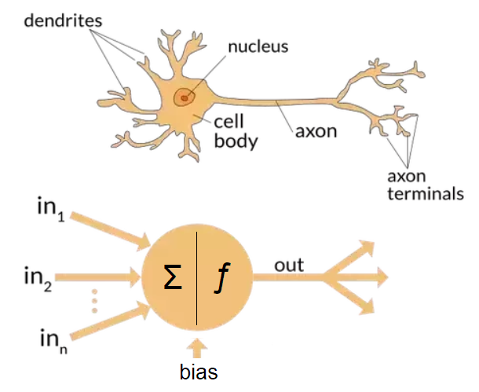
UNIT-1 Artificial Neural Network
Artificial Neural Network:

Slide 75
UNIT-1 Artificial Neural Network
Artificial Neural Network:
An Artificial Neural Network (ANN) is a computational model inspired by the structure and functioning of biological neural networks in the human brain.
It is a key component of the field of machine learning and artificial intelligence.
ANNs are used to model complex relationships and patterns in data, and they excel at tasks like classification, regression, and pattern recognition.
An ANN is composed of interconnected nodes, also called neurons, organized into layers.
The neurons are designed to process and transmit information using a combination of mathematical operations and activation functions.
The basic concept of an ANN involves receiving input data, passing it through multiple layers of interconnected neurons, and producing an output or prediction based on the learned patterns.

Slide 76
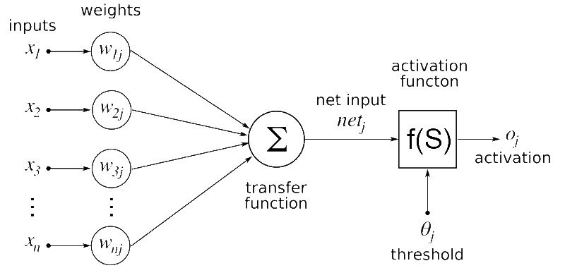
UNIT-1 Artificial Neural Network
Structure of ANN
The structure of an ANN typically includes:
Input Layer: The initial layer that receives the input data or features. Each neuron in this layer corresponds to a specific feature in the input data.
Hidden Layers: Intermediate layers between the input and output layers. These layers are responsible for processing the input data through a series of weighted connections and activation functions. Hidden layers allow ANNs to learn complex features and representations.
Output Layer: The final layer that produces the prediction or output. The number of neurons in this layer depends on the type of task the ANN is designed for. For example, in a binary classification task, there might be one output neuron with a sigmoid activation function.

Slide 77
UNIT-1 Artificial Neural Network
Structure of ANN
The structure of an ANN typically includes:
Neurons
Neurons simulate biological neurons, processing inputs and producing outputs.
Each neuron computes a weighted sum of its inputs, applies an activation function, and passes the result to the next layer.
Weights and Biases:
Each connection between neurons has an associated weight, indicating its importance.
Biases are added to the weighted sum to introduce flexibility.

Slide 78
UNIT-1 Artificial Neural Network
Structure of ANN
The structure of an ANN typically includes:
Activation Functions
Non-linear functions applied to the weighted sum to introduce non-linearity.
Common activation functions include ReLU, sigmoid, and tanh.

Slide 79
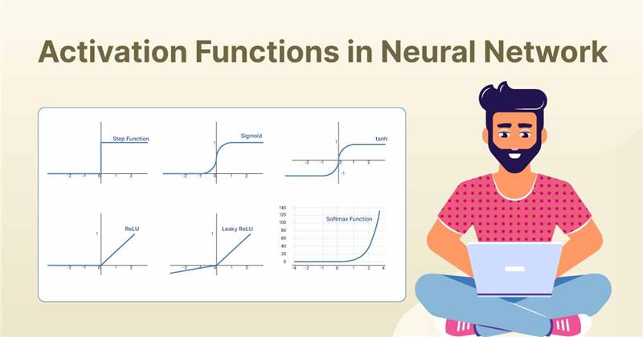
UNIT-1 Artificial Neural Network
Activation Functions(AF)
Activation functions introduce non-linearity to the network.
In absence of AF, ANNs would be limited to representing linear relationships, that restrict to learn complex patterns and relationships in data.

Slide 80
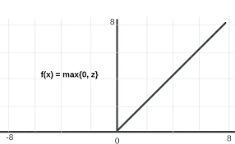
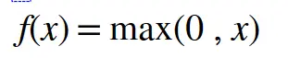
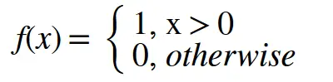
UNIT-1 Artificial Neural Network
Activation Functions(AF)
ReLU (Rectified Linear Unit):
A rectified linear unit (ReLU) is an activation function that introduces the property of non-linearity to a deep learning model and solves the vanishing gradients issue.
"It interprets the positive part of its argument.
It is one of the most popular activation functions in deep learning.
The variants of ReLU include
leaky ReLU,
exponential linear unit (ELU) and
Sigmoid linear unit (SiLU)
Mathematical Representatio
Derivative

Slide 81
UNIT-1 Artificial Neural Network
Activation Functions(AF)
ReLU Advantages:
Non-linearity: ReLU introduces non-linearity to the model, allowing it to learn complex patterns and relationships in the data. This is crucial for neural networks to model a wide range of functions effectively.
Computationally Efficient: ReLU activation is computationally efficient to compute during both forward and backward passes of training. The activation only involves simple thresholding of values, which leads to faster training times compared to more complex activation functions like sigmoid or tanh.
Sparse Activation: ReLU has a characteristic called "sparse activation." It means that only a subset of neurons is activated for any given input. This sparsity can lead to more efficient learning and reduced overfitting, as neurons are less likely to co-adapt.
Mitigating Vanishing Gradient: Unlike sigmoid and tanh functions, ReLU does not saturate for positive inputs, which helps mitigate the vanishing gradient problem. This makes training deeper networks more feasible as gradients can flow more effectively through the network during backpropagation.
Empirical Success: ReLU has shown remarkable empirical success in various deep learning applications, including image and speech recognition, natural language processing, and more. It has contributed to the rise of deep learning in recent years.

Slide 82
UNIT-1 Artificial Neural Network
Activation Functions(AF)
ReLU Disadvantages:
Dying ReLU Problem: One significant issue with ReLU is the "dying ReLU" problem. During training, some neurons can become inactive (output zero for all inputs) and stay that way. Once a large gradient flows through a ReLU neuron and updates its weights such that it always produces negative outputs, it will never activate again. This leads to dead neurons that do not contribute to learning.
Not Zero-Centered: ReLU is not zero-centered, meaning the output of ReLU is always positive or zero. This can lead to issues in weight updates during training and can affect convergence.
Unbounded Activation: ReLU does not have an upper bound, which means that if a large gradient flows through a ReLU neuron, it can lead to "exploding gradients," causing training instability.
Sensitivity to Initialization: ReLU neurons can be sensitive to weight initialization. If the initial weights are too large, it's more likely for neurons to get stuck in the inactive state, contributing to the dying ReLU problem.
Leaky ReLU and Variants: To address some of the issues with standard ReLU, variations like Leaky ReLU, Parametric ReLU, and Exponential Linear Units (ELUs) have been proposed. These variations introduce controlled non-zero slopes for negative inputs or introduce other adaptive characteristics to mitigate the disadvantages of ReLU.

Slide 83


UNIT-1 Artificial Neural Network
Activation Functions(AF)
Sigmoid:
The sigmoid function squashes the input into a range between 0 and 1.
It's often used in the output layer for binary classification tasks.
Mathmatical Representation
Derivative of the sigmoid function

Slide 84
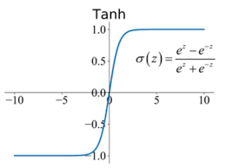
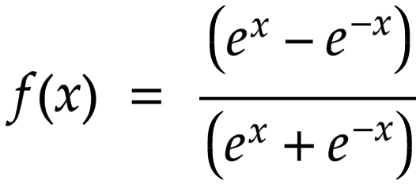
UNIT-1 Artificial Neural Network
Activation Functions(AF)
Tanh (Hyperbolic Tangent):
The tanh function also squashes the input, but between -1 and 1.
It's often used in hidden layers to introduce non-linearity.
The Tanh Activation function is widely used in neural networks due to its centered, zero-mean output, which helps mitigate the vanishing gradient problem that occurs with the sigmoid activation function.
The zero-centered property facilitates faster convergence during the training process, as it avoids biasing the updates in one particular direction.
Mathmatical Representation
To know more refer : https://www.nomidl.com/deep-learning/what-is-tanh-activation-function/

Slide 85
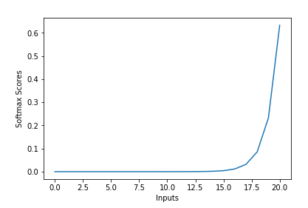
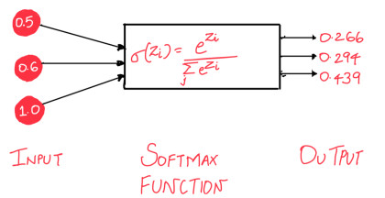
UNIT-1 Artificial Neural Network
Activation Functions(AF)
Softmax:
The softmax function is used in the output layer for multi-class classification tasks.
It converts a vector of values into a probability distribution, making it suitable for selecting one class from multiple options.
The softmax function is sometimes called the softargmax function, or multi-class logistic regression.
The softmax function can be used in a classifier only when the classes are mutually exclusive.

Slide 86
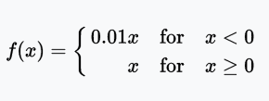
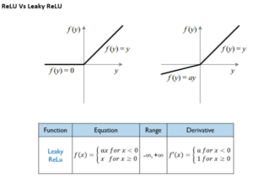
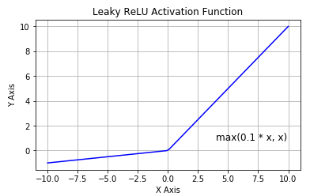
UNIT-1 Artificial Neural Network
Activation Functions(AF)
Leaky ReLU:
Similar to ReLU, but allows a small negative slope for inputs below zero.
This mitigates the "dying ReLU" problem where neurons can get stuck during training.
Leaky ReLU(x) = x if x > 0, and alpha * x if x <= 0 (where alpha is a small positive constant).

Slide 87
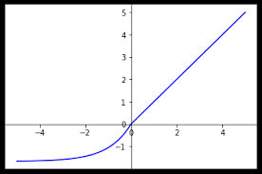
UNIT-1 Artificial Neural Network
Activation Functions(AF)
ELU (Exponential Linear Unit):
ELU is similar to ReLU for positive inputs, but it has a non-zero gradient for negative inputs, which can help with preventing dead neurons.

Slide 88
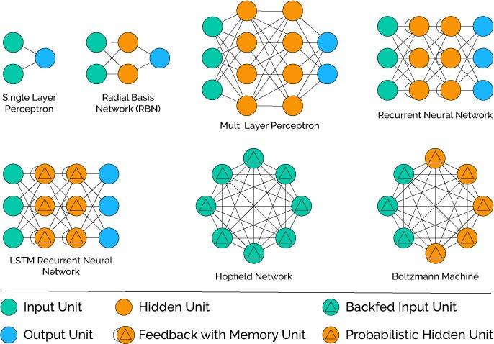
UNIT-1 Artificial Neural Network
Neural Network Architecture

Slide 89
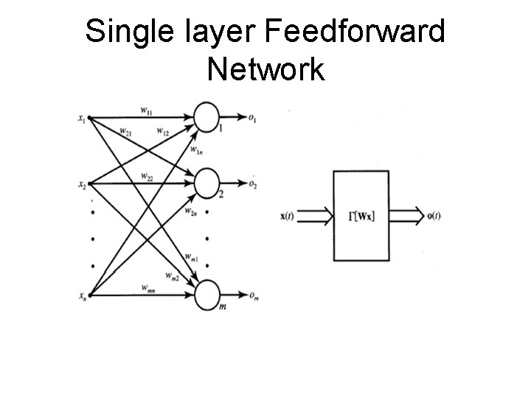
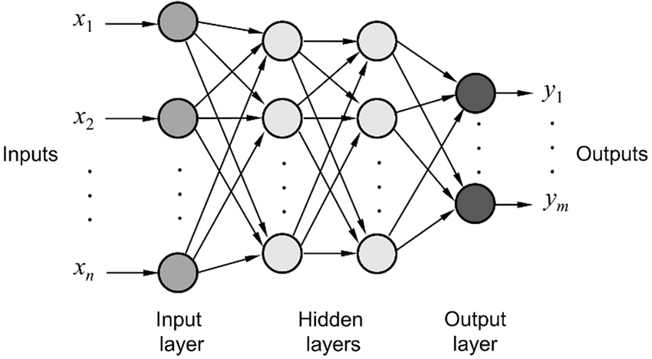
UNIT-1 Artificial Neural Network
Neural Network Architecture
Feedforward Neural Networks (FNNs): These are the simplest type of neural networks, consisting of an input layer, one or more hidden layers, and an output layer. Neurons are connected only in one direction, from the input layer to the output layer. FNNs are used for tasks like regression and classification.
Multi-Layer Feedforward Neural Network

Slide 90
UNIT-1 Artificial Neural Network
Neural Network Architecture
Single Layer Feed Forward Neural Network
A Single Layer Feedforward Neural Network, also known as a
Perceptron,
It is the simplest type of neural network architecture.
It consists of only one layer of neurons, which directly connects
the input to the output.
This type of network is primarily used for binary classification
tasks where the input features are linearly separable.
Structure:
Input Layer:
The input layer consists of input nodes, each representing a feature of the input data.
These nodes do not perform any computation; they simply pass the input values to the output layer.
Output Layer:
The output layer consists of a single node or neuron. The output of this neuron is determined by a weighted sum of the input values along with a bias term.
The output is then passed through an activation function to produce the final prediction or output of the network.

Slide 91
UNIT-1 Artificial Neural Network
Single Layer Feed Forward Neural Network (Example)
Problem: Classify whether a fruit is an apple or a banana based on two features: fruit diameter (in centimeters) and fruit weight (in grams). We have a dataset with labeled examples of apples and bananas.
Network Architecture:
A single-layer neural network for this problem consists of two input neurons (one for diameter and one for weight) and one output neuron for binary classification.
Activation Function:
Typically, a step function or a sigmoid function is used as the activation function in single-layer perceptrons. In this example, we'll use a step function.
Weights and Bias:
The network assigns weights to each input feature and has a bias term. These weights and bias are learned during training.
Training:
During training, the network adjusts the weights and bias to minimize the classification error. The weights and bias are updated using a learning algorithm like the perceptron learning rule.

Slide 92
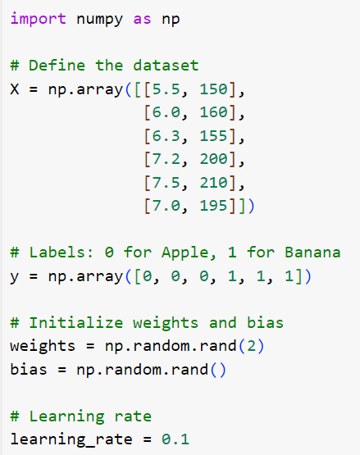
UNIT-1 Artificial Neural Network
Single Layer Feed Forward Neural Network (Example)

Slide 93
UNIT-1 Artificial Neural Network
Neural Network Architecture
Single Layer Feed Forward Neural Network
Activation Function:
The activation function is typically a step function or a sigmoid function.
The step function returns a binary output based on whether the weighted sum is above a certain threshold, while the sigmoid function produces a continuous output between 0 and 1.
The choice of activation function depends on the problem at hand.
Limitations:
A single-layer feedforward neural network can only learn linear decision boundaries. It cannot capture complex patterns in the data that are not linearly separable.
It might struggle with problems that require more sophisticated feature extraction or involve non-linear relationships.

Slide 94
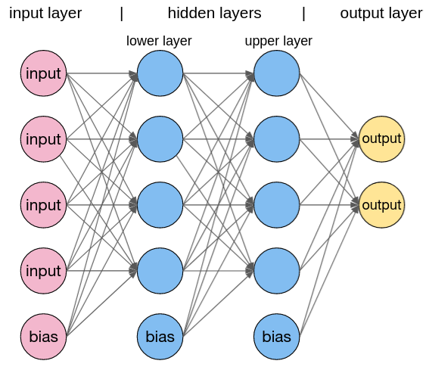
UNIT-1 Artificial Neural Network
Neural Network Architecture
Multi Layer Feed Forward Neural Network
It is also referred as a Multi-Layer Perceptron (MLP), is a type of artificial neural network with a more complex architecture compared to its single-layer counterpart.
It is designed to handle a wide range of machine learning tasks, especially those involving complex and nonlinear relationships within data.
Multi-layer neural networks have found extensive applications in areas such as image recognition, natural language processing, speech recognition, and many other domains.

Slide 95
UNIT-1 Artificial Neural Network
Multi Layer Feed Forward Neural Network
Architecture:
It consists of three or more layers:
Input Layer: This layer receives the raw input data, and each neuron in this layer represents a feature or attribute of the input.
Hidden Layers: These are one or more layers placed between the input and output layers. Each hidden layer contains multiple neurons, and these layers introduce nonlinearity into the network. The presence of hidden layers enables the network to model complex, hierarchical patterns and relationships in the data.
Output Layer: The output layer produces the final result of the network's computation. The number of neurons in this layer depends on the specific task, with binary classification tasks having one neuron, multi-class classification having one neuron per class, and regression tasks having one or more neurons for the output.
Functionality:
Multi-layer neural networks excel at approximating complex functions and capturing intricate patterns within data. They can represent both linear and nonlinear transformations of input data, making them highly versatile for a wide range of machine learning tasks. This versatility is achieved through the following key components:
Activation Functions: Nonlinear activation functions, such as ReLU (Rectified Linear Unit), sigmoid, and tanh, are applied to the neurons in the hidden layers. These functions introduce nonlinearity into the network, allowing it to model complex relationships.
Weighted Connections: Each connection between neurons in adjacent layers has an associated weight, which determines the strength of the connection. These weights are learned during training to optimize the network's performance.
Backpropagation: Multi-layer neural networks are typically trained using the backpropagation algorithm, combined with gradient descent optimization. This involves iteratively adjusting the weights to minimize the error between the predicted and actual output.

Slide 96
UNIT-1 Artificial Neural Network
Multi Layer Feed Forward Neural Network
Applications:
Multi-layer neural networks have demonstrated remarkable success in various machine learning and artificial intelligence tasks, including:
Image Recognition: Convolutional neural networks (CNNs), a specialized type of multi-layer network, have achieved state-of-the-art performance in image classification, object detection, and segmentation tasks.
Natural Language Processing: Multi-layer neural networks, such as recurrent neural networks (RNNs) and long short-term memory networks (LSTMs), are used for tasks like text generation, sentiment analysis, and machine translation.
Speech Recognition: Multi-layer networks have been applied to automatic speech recognition (ASR) systems, converting spoken language into text.
Recommendation Systems: They are used in collaborative filtering and content-based recommendation systems to personalize content recommendations for users.

Slide 97
UNIT-1 Artificial Neural Network
Multi Layer Feed Forward Neural Network
Problem: Classify whether a bank customer will churn (leave the bank) or stay based on features such as their credit score, age, tenure, and balance.
Data:
We'll use a synthetic dataset with the following features:
Credit Score
Age
Tenure
Balance
Network Architecture:
For this example, we'll create an MLP with three hidden layers, each containing 64 neurons. The input layer will have four neurons (one for each feature), and the output layer will have one neuron for binary classification.
Activation Function:
We'll use the Rectified Linear Unit (ReLU) activation function for hidden layers and a sigmoid activation function for the output layer.

Slide 98
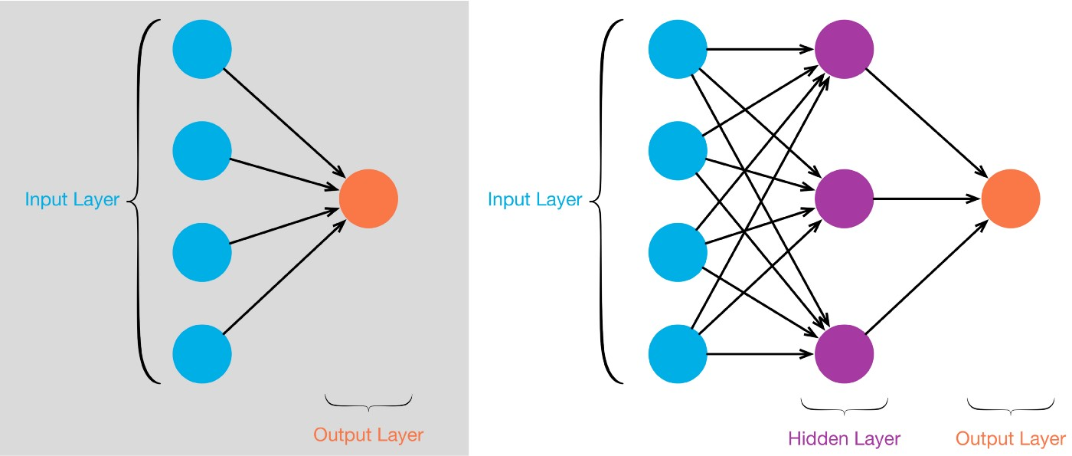
UNIT-1 Artificial Neural Network
Differences between Single layer and Multi-Layer Neural Networks

Slide 99
UNIT-1 Artificial Neural Network
Neural Network Architecture
Differences between Single layer and Multi-Layer Neural Networks
Architecture:
Single-layer neural network: It consists of only one layer of neurons, which is often called the input layer. There are no hidden layers or multiple layers of neurons between the input and output.
Multi-layer neural network: It has more than one layer of neurons, typically including an input layer, one or more hidden layers, and an output layer. The layers between the input and output are called hidden layers.
Capabilities:
Single-layer neural network: It can only model linearly separable functions. In other words, it can solve simple problems where the data can be separated by a straight line or hyperplane.
Multi-layer neural network: It can approximate complex, nonlinear functions. By adding hidden layers and using nonlinear activation functions, MLPs can capture intricate patterns and relationships in data, making them capable of handling a wide range of tasks, including classification, regression, and more.

Slide 100
UNIT-1 Artificial Neural Network
Neural Network Architecture
Differences between Single layer and Multi-Layer Neural Networks
Representation:
Single-layer neural network: These networks can represent linear transformations of the input data, making them limited in their ability to capture complex relationships in the data.
Multi-layer neural network: The presence of hidden layers allows MLPs to represent both linear and nonlinear transformations of the input data. This enables them to model complex, hierarchical features and relationships within the data.
Activation functions:
Single-layer neural network: Typically uses linear activation functions, which result in linear transformations of the input.
Multi-layer neural network: Uses nonlinear activation functions (e.g., sigmoid, ReLU, tanh) in the hidden layers to introduce nonlinearity into the network, enabling it to learn and represent nonlinear relationships.

Slide 101
UNIT-1 Artificial Neural Network
Neural Network Architecture
Differences between Single layer and Multi-Layer Neural Networks
Learning and Training:
Single-layer neural network: Training is relatively straightforward and can often be done using simple algorithms like the perceptron learning rule.
Multi-layer neural network: Training is more complex and usually requires advanced optimization techniques like backpropagation and gradient descent. These networks benefit from the use of gradient-based optimization methods to adjust the weights and biases during training.
Use Cases:
Single-layer neural network: Suitable for simple tasks like binary classification or linear regression when the data is linearly separable.
Multi-layer neural network: Suited for a wide range of tasks, including image recognition, natural language processing, speech recognition, and more, where the data has complex and nonlinear relationships.

Slide 102
UNIT-1 Artificial Neural Network
Neural Network Architecture

Slide 103
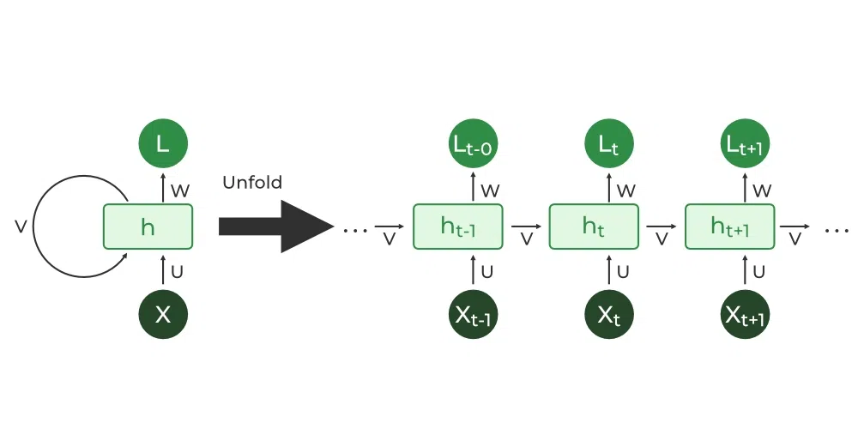
UNIT-1 Artificial Neural Network
Neural Network Architecture
Recurrent Neural Networks (RNNs):
RNNs are designed to handle sequences of data, making them suitable for tasks such as natural language processing and time series analysis.
Recurrent Neural Network(RNN) is a type of Neural Network where the output from the previous step is fed as input to the current step.
Hidden state that is also known as Memory State is the main and most important features of RNN which remembers some information about a sequence.

Slide 104
UNIT-1 Artificial Neural Network
Various Learning Techniques
Supervised Learning:
Linear Regression: Used for regression tasks to predict continuous numerical values.
Logistic Regression: Used for binary or multi-class classification tasks.
Decision Trees: Suitable for both regression and classification tasks, creating a tree-like model to make decisions.
Random Forests: An ensemble method based on decision trees for improved accuracy and robustness.
Support Vector Machines (SVM): Effective for classification tasks, especially when dealing with high-dimensional data.
K-Nearest Neighbors (K-NN): Makes predictions based on the majority class among its k-nearest neighbors in the feature space.
Neural Networks: Deep learning models with multiple layers of interconnected neurons, used for various tasks including image recognition and natural language processing.

Slide 105
UNIT-1 Artificial Neural Network
Various Learning Techniques
Unsupervised Learning:
Clustering: Grouping similar data points together, e.g., K-Means clustering and hierarchical clustering.
Dimensionality Reduction: Reducing the number of features while retaining essential information, e.g., Principal Component Analysis (PCA) and t-Distributed Stochastic Neighbor Embedding (t-SNE).
Generative Models: Learning the underlying distribution of the data, e.g., Gaussian Mixture Models (GMMs) and Variational Autoencoders (VAEs).
Association Rule Mining: Discovering interesting relationships between variables in a dataset, e.g., Apriori algorithm for market basket analysis.

Slide 106
UNIT-1 Artificial Neural Network
Various Learning Techniques
Reinforcement Learning:
Q-Learning: A model-free reinforcement learning algorithm that learns action-value functions to make optimal decisions in Markov Decision Processes (MDPs).
Deep Q-Networks (DQN): Combines Q-learning with deep neural networks to handle complex and high-dimensional state spaces.
Policy Gradients: Directly learning a policy that maps states to actions, often used in continuous action spaces.
Actor-Critic Methods: Combining both policy and value function approximation, with an actor making decisions and a critic estimating the value of those decisions.

Slide 107
UNIT-1 Artificial Neural Network
Various Learning Techniques
Semi-Supervised Learning:
A hybrid approach that combines labeled and unlabeled data to improve model performance, especially when labeled data is scarce.
Techniques include self-training, label propagation, and co-training.
Self-Supervised Learning:
A type of unsupervised learning where the model learns from the data itself without external labels. It often involves generating pretext tasks and leveraging the learned representations for downstream tasks.
Transfer Learning:
Leveraging knowledge gained from one task or domain to improve performance on a related task or domain. It's common in deep learning and fine-tuning pre-trained models.
Ensemble Learning:
Combining multiple models to improve performance and reduce overfitting. Techniques include bagging, boosting, and stacking.

Slide 108
UNIT-1 Artificial Neural Network
Perceptron Rules
Supervised Learning Algorithm: The Perceptron Rule is a supervised learning algorithm used for binary classification tasks.
Developed by Frank Rosenblatt: It was developed by Frank Rosenblatt in the late 1950s.
Objective: The main goal of the Perceptron Rule is to learn a linear decision boundary that can separate two classes of data points in a feature space.
Linear Separability: It is suitable for problems where the data is linearly separable, meaning it can be separated by a straight line (or hyperplane in higher dimensions).
Components: The algorithm works with input features, weights, an activation function (typically a step function), and a bias term (threshold).
Training: It iteratively updates the weights based on misclassified data points until a stopping criterion is met. Correctly classified points do not trigger weight updates.

Slide 109
UNIT-1 Artificial Neural Network
Perceptron Rules
Update Rule: When a data point is misclassified as class 0 when it should be class 1, the weights are increased for the associated features. When misclassified as class 1 when it should be class 0, the weights are decreased for the associated features.
Limitations: The Perceptron Rule can only solve linearly separable problems and cannot handle tasks with nonlinear decision boundaries.
Historical Significance: It played a pivotal role in the history of machine learning and served as a foundation for more complex neural network models like multi-layer perceptrons (MLPs).
Activation Function: Typically uses a step function for making binary decisions based on the weighted sum of inputs.
Bias: A bias term (threshold) is used to shift the decision boundary.
Supervised Learning: Requires labeled training data for learning and updating weights.
Early Neural Network: Represents one of the earliest forms of artificial neural networks and contributed to the development of the field.

Slide 110
UNIT-1 Artificial Neural Network
Convergence Rules
Convergence in Machine Learning: Convergence refers to the point where an iterative algorithm reaches a stable solution. It's a critical concept in machine learning and optimization.
Objective: The goal of convergence is to find an optimal solution, often defined by minimizing an objective function or meeting specific criteria.
Criteria for Convergence: The specific criteria for convergence can vary depending on the algorithm and problem. Common criteria include:
A small change in the objective function or loss function between iterations.
Reaching a predefined maximum number of iterations.
Achieving a specific level of accuracy or error tolerance.
Satisfying certain mathematical conditions, like gradient descent reaching a stationary point.

Slide 111
UNIT-1 Artificial Neural Network
Convergence Rules
Iterative Algorithms: Many machine learning and optimization algorithms are iterative in nature, meaning they repeatedly update their parameters or variables to approach an optimal solution.
Examples: Convergence rules apply to various algorithms, including gradient descent, stochastic gradient descent, Newton's method, expectation-maximization (EM), and more.
Convergence in Neural Networks: In neural network training, convergence is often measured by observing the decrease in the loss function (e.g., mean squared error) over iterations or epochs. Training stops when the loss converges to a stable value.
Stopping Criteria: Determining appropriate stopping criteria is essential for avoiding overfitting (continuing training beyond the optimal point) or underfitting (stopping prematurely).

Slide 112
UNIT-1 Artificial Neural Network
Convergence Rules
Importance: Convergence is crucial for ensuring that machine learning models and optimization algorithms find meaningful solutions efficiently and reliably.
Convergence Rule in Gradient Descent: In gradient descent optimization, a common convergence rule is to stop when the change in the loss function between iterations falls below a certain threshold.
Trade-Off: Balancing convergence with computational resources is essential. Too many iterations may lead to slow training, while too few may result in suboptimal solutions.
Monitoring Convergence: Practitioners often monitor convergence during training by plotting the loss or objective function's values over time and observing when it stabilizes.
Convergence in Unsupervised Learning: In unsupervised learning, such as clustering or dimensionality reduction, convergence may refer to the stability of cluster assignments or the convergence of the algorithm's objectives (e.g., variance reduction in PCA).

Slide 113
UNIT-1 Artificial Neural Network
Convergence Rules
Adaptive Methods: Some algorithms, like adaptive learning rate methods in optimization (e.g., Adam), dynamically adjust their behavior during training, which can affect the criteria for convergence.
Convergence and Hyperparameter Tuning: Selecting appropriate hyperparameters (e.g., learning rate, batch size) can impact convergence, and fine-tuning these hyperparameters is often part of model development.
Early Stopping: A common practice in machine learning is early stopping, where training is halted when no significant improvement in the objective function is observed for a predefined number of iterations.
Convergence in Reinforcement Learning: In reinforcement learning, convergence may refer to the stability of the policy or value function during training.

Slide 114
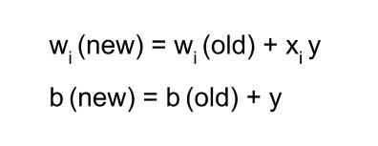
UNIT-1 Artificial Neural Network
Hebb Learning.
Proposed by Donald O Hebb.
It is used for pattern classification.
It is a single layer neural network, i.e. it has one input layer and one output layer.
The input layer can have many units, say n but The output layer only has one unit.
Hebbian rule works by updating the weights between neurons in the neural network for each training sample.
Hebbian Learning Rule Algorithm :
Set all weights to zero, w_{i} = 0 for i=1 to n, and bias to zero.
For each input vector, S(input vector) : t(target output pair), repeat steps 3-5.
Set activations for input units with the input vector X_{i} = S_{i} for i = 1 to n.
Set the corresponding output value to the output neuron, i.e. y = t.
Update weight and bias by applying Hebb rule for all i = 1 to n:

Slide 115
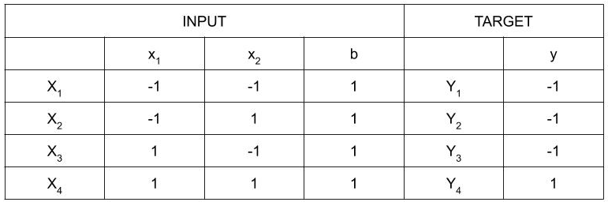
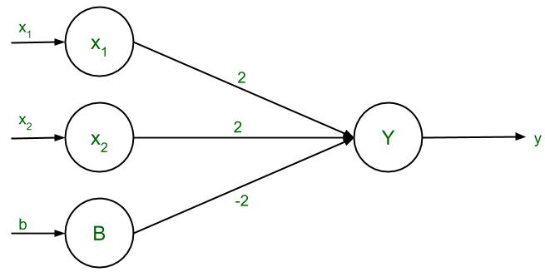
UNIT-1 Artificial Neural Network
Implementation of AND gate using Hebb Learning.
Step 1 : Set weight and bias to zero, w = [ 0 0 0 ]^{T} and b = 0.
Step 2 : Set input vector Xi = Si for i = 1 to 4.
X₁ = [ -1 -1 1 ]^{T}
X₂ = [ -1 1 1 ]^{T}
X₃ = [ 1 -1 1 ]^{T}
X₄ = [ 1 1 1 ]^{T}
Step 3 : Output value is set to y = t.
Step 4 : Modifying weights using Hebbian Rule:
First iteration –
w(new) = w(old) + x₁y₁ = [ 0 0 0 ]^{T} + [ -1 -1 1 ]^{T} . [ -1 ] = [ 1 1 -1 ]^{T}
For the second iteration, the final weight of the first one will be used and so on.
Second iteration –
w(new) = [ 1 1 -1 ]^{T} + [ -1 1 1 ]^{T} . [ -1 ] = [ 2 0 -2 ]^{T}
Third iteration –
w(new) = [ 2 0 -2]^{T} + [ 1 -1 1 ]^{T} . [ -1 ] = [ 1 1 -3 ]^{T}
Fourth iteration –
w(new) = [ 1 1 -3]^{T} + [ 1 1 1 ]^{T} . [ 1 ] = [ 2 2 -2 ]^{T}
So, the final weight matrix is [ 2 2 -2 ]^{T}

Slide 116
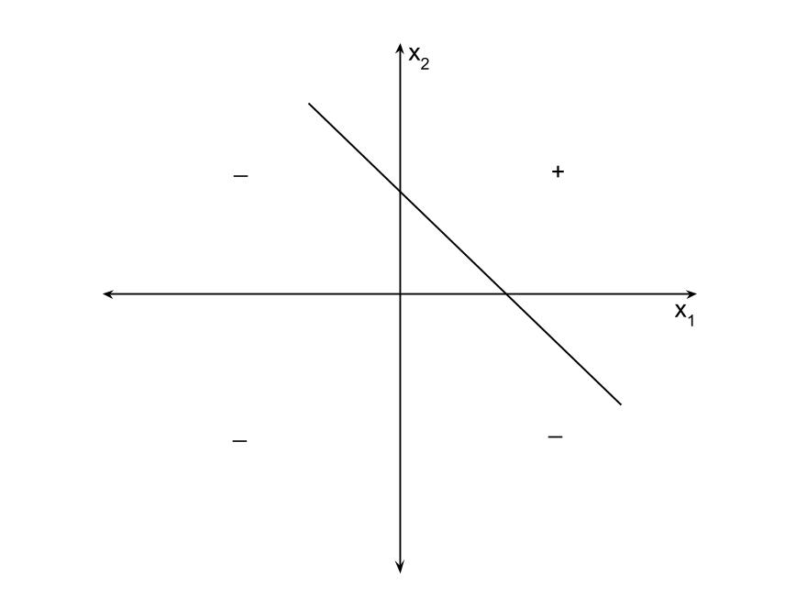
UNIT-1 Artificial Neural Network
Testing the network :
For x₁ = -1, x₂ = -1, b = 1, Y = (-1)(2) + (-1)(2) + (1)(-2) = -6
For x₁ = -1, x₂ = 1, b = 1, Y = (-1)(2) + (1)(2) + (1)(-2) = -2
For x₁ = 1, x₂ = -1, b = 1, Y = (1)(2) + (-1)(2) + (1)(-2) = -2
For x₁ = 1, x₂ = 1, b = 1, Y = (1)(2) + (1)(2) + (1)(-2) = 2
The results are all compatible with the original table.
Decision Boundary :
2x₁ + 2x₂ – 2b = y
Replacing y with 0, 2x₁ + 2x₂ – 2b = 0
Since bias, b = 1, so 2x₁ + 2x₂ – 2(1) = 0
2( x₁ + x₂ ) = 2
The final equation, x₂ = -x₁ + 1

Slide 117
UNIT-1 Artificial Neural Network
Gradient Descent
Gradient Descent is used to optimize the weight and biases based on the cost function.
cost function evaluates the difference between the actual and predicted outputs.
A gradient is nothing but a derivative that defines the effects on outputs of the function with a little bit of variation in inputs.
Gradient Descent (GD) is a widely used optimization algorithm in deep learning that is used to minimize the cost function of a neural network model during training.
It works by iteratively adjusting the weights or parameters of the model in the direction of the negative gradient of the cost function until the minimum of the cost function is reached.
The main objective of using a gradient descent algorithm is to minimize the cost function using iteration.

Slide 118
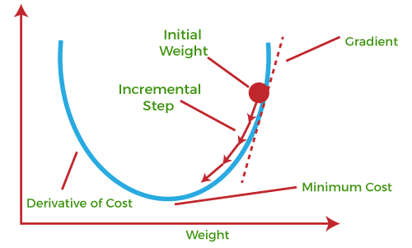
UNIT-1 Artificial Neural Network
Gradient Descent
The best way to define the local minimum or local maximum of a function using gradient descent is as follows:
If we move towards a negative gradient or away from the gradient of the function at the current point, it will give the local minimum of that function.
Whenever we move towards a positive gradient or towards the gradient of the function at the current point, we will get the local maximum of that function.
This entire procedure is known as Gradient Ascent, which is also known as steepest descent.
The main objective of using a gradient descent algorithm is to minimize the cost function using iteration. To achieve this goal, it performs two steps iteratively:
Calculates the first-order derivative of the function to compute the gradient or slope of that function.
Move away from the direction of the gradient, which means slope increased from the current point by alpha times, where Alpha is defined as Learning Rate. It is a tuning parameter in the optimization process which helps to decide the length of the steps.

Slide 119
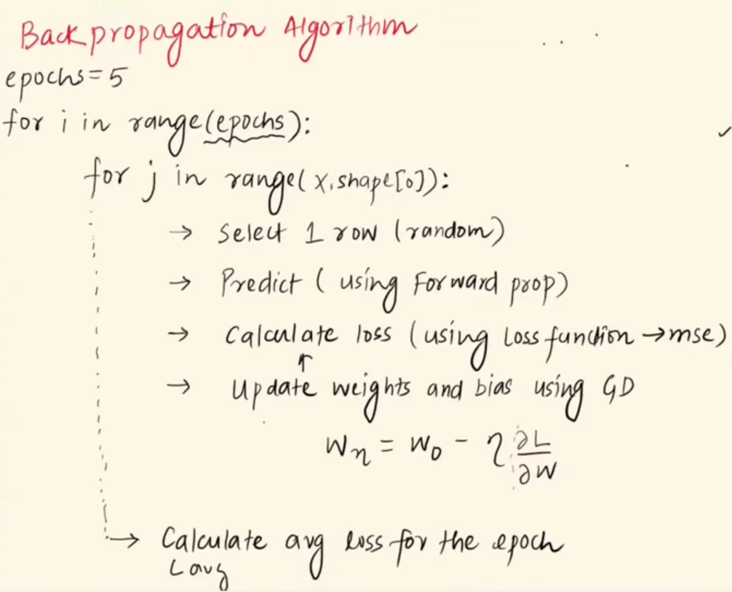
UNIT-1 Artificial Neural Network
Gradient Descent

Slide 120
UNIT-1 Artificial Neural Network
Derivation of Gradient Descent
derivation of the gradient descent update rule for minimizing a cost function J(θ), where θ represents the parameters of the model:
Define the cost function:
J(θ) is a function that measures how well the model's predictions match the actual values in the training data. The goal is to minimize this cost function.
Calculate the gradient:
Compute the gradient (or derivative) of the cost function with respect to the parameters θ. This gradient represents the direction and magnitude of the steepest increase in the cost function:
∇J(θ) = [∂J/∂θ₁, ∂J/∂θ₂, ..., ∂J/∂θₙ]
Each component of ∇J(θ) tells you how much the cost function will change if you make a small change to the corresponding parameter θᵢ.
Initialize parameters:
Start with an initial guess for the parameters θ, denoted as θ₀.
Update parameters iteratively:
The gradient descent update rule is as follows:
θ_{k}₊₁ = θₖ - α∇J(θₖ)
Where:
θₖ is the current estimate of the parameters at iteration k.
α (alpha) is the learning rate, a hyperparameter that determines the step size or the size of each update.
∇J(θₖ) is the gradient of the cost function at the current parameter values θₖ.

Slide 121
UNIT-1 Artificial Neural Network
Derivation of Gradient Descent
The update rule effectively adjusts the parameters in the direction opposite to the gradient, scaled by the learning rate α.
It repeats this process until a stopping criterion is met, typically when the change in the cost function becomes very small or a fixed number of iterations is reached.
Convergence:
With each iteration, the parameters θ move closer to the values that minimize the cost function. Gradient descent will converge to a local minimum of the cost function, which represents the best parameter values for the model with respect to the training data.
Repeat until convergence:
Continue the update process until the stopping criterion is met or until the algorithm converges to a minimum.

Slide 122
UNIT-1 Artificial Neural Network
Types of Gradient Descent
Batch Gradient Descent (BGD) or Vanilla Descent:
BGD computes the gradient of the cost function with respect to the entire training dataset in each iteration.
It can be computationally expensive for large datasets since it requires processing the entire dataset for each update.
BGD often provides stable and deterministic convergence to the minimum.
Stochastic Gradient Descent (SGD):
In SGD, each iteration randomly selects a single data point (or a small random subset, called a mini-batch) to compute the gradient and update the parameters.
SGD is faster and can handle large datasets more efficiently than BGD.
It introduces more noise in the parameter updates but can escape local minima and explore the parameter space more effectively.
Mini-Batch Gradient Descent:
Mini-batch gradient descent is a compromise between BGD and SGD. It uses a small random subset (mini-batch) of the training data in each iteration.
It combines the benefits of both BGD (stable convergence) and SGD (efficiency and noise reduction).
The mini-batch size is a hyperparameter that can be tuned.

Slide 123
UNIT-1 Artificial Neural Network
Delta Rule
Delta Rule [also known as the Widrow & Hoff Learning rule or the Least Mean Square (LMS) rule] was invented by Widrow and Hoff.
The Delta Rule is primarily used for binary classification problems, where the goal is to separate two classes of data points by finding an appropriate decision boundary.
Working
Initialization: Initialize the weights of the neuron or node to small random values.
Forward Pass:
For each input data point, compute the weighted sum of the inputs using the current weights:
net_input = ∑(weight_i * input_i)
Apply an activation function (often a step function or sign function) to the net input to obtain the predicted output of the neuron:
predicted_output = activation_function(net_input)
Error Calculation:
Compare the predicted output to the actual target value (ground truth) for the input data point to calculate the error:
error = target_output - predicted_output
Weight Update (Delta Rule):
Adjust the weights of the neuron based on the error calculated in the previous step. The weight update formula is as follows:
weight_i_new = weight_i_old + learning_rate * error * input_i

Slide 124
UNIT-1 Artificial Neural Network
Delta Rule
Repeat:
Repeat steps 2 to 4 for all training data points.
Continue iterating through the entire dataset for multiple epochs (iterations) or until the error converges to a satisfactory level.
Convergence:
The Delta Rule iteration continues until the error decreases to an acceptable level or until a predefined stopping criterion is met.

Slide 125
UNIT-1 Assignment-01
Describe methods like grid search and random search for hyperparameter tuning.
Describe the backpropagation algorithm used to train MLPs. How does it update weights and biases to minimize the loss function?
Discuss common dimensionality reduction techniques, such as Principal Component Analysis (PCA) and t-Distributed Stochastic Neighbor Embedding (t-SNE).
Discuss techniques for detecting and mitigating overfitting and underfitting in machine learning models.
Explain how the ROC curve and AUC can be used to evaluate model performance.

Slide 126
UNIT-1 Assignment-01
What is the primary objective of deep learning?
a) Feature extraction
b) Dimensionality reduction
c) Automated feature learning
d) Clustering
Which of the following is NOT an activation function commonly used in deep learning?
a) Sigmoid
b) ReLU
c) Tanh
d) K-Means
Which type of neural network is well-suited for image classification tasks?
a) Convolutional Neural Network (CNN)
b) Recurrent Neural Network (RNN)
c) Multilayer Perceptron (MLP)
d) Radial Basis Function Network (RBFN)

Slide 127
UNIT-1 Assignment-01
What is the primary purpose of dropout in deep learning?
a) Enhancing model generalization
b) Reducing the number of layers
c) Increasing the learning rate
d) Eliminating outliers
In gradient descent, what is the learning rate responsible for?
a) The rate of convergence
b) The size of the neural network
c) The number of epochs
d) The choice of activation function
What problem in deep learning can occur when gradients become extremely small, causing the network to stop learning?
a) Vanishing gradients
b) Exploding gradients
c) Overfitting
d) Dropout

Slide 128
UNIT-1 Assignment-01
Which deep learning architecture is well-suited for sequential data, such as natural language processing?
a) CNN
b) RNN
c) GAN
d) MLP
What is transfer learning in deep learning?
a) Training a model from scratch
b) Using pre-trained models and fine-tuning them for a specific task
c) Transforming data before feeding it into a neural network
d) Transferring data between different devices
Which deep learning framework is developed by Google and widely used in research and industry?
a) PyTorch
b) Caffe
c) Keras
d) TensorFlow

Slide 129
UNIT-1 Assignment-01
What is the primary purpose of a loss function in deep learning?
a) To initialize network weights
b) To measure the accuracy of predictions
c) To visualize data
d) To preprocess input data

Slide 130
UNIT-1 References
https://www.mygreatlearning.com/blog/understanding-curse-of-dimensionality/
https://www.analyticsvidhya.com/blog/2021/10/evaluation-metric-for-regression-models/
https://medium.com/swlh/recall-precision-f1-roc-auc-and-everything-542aedf322b9
https://towardsdatascience.com/metrics-to-evaluate-your-machine-learning-algorithm-f10ba6e38234
https://www.javatpoint.com/cross-validation-in-machine-learning

Slide 132
Model Improvement and Performance
UNIT-1 Content
MODULE -01

